Slide 1
PurpleAir Monitor Program
Zachary Thoroughgood

Slide 2

Initial Set of Goals
Interpret Programs (Fetch.py and MapMaker.py)
Create Testing Environment
PurpleAir Machines to Test
Set-up Program Testing
Establish a Collection of .CSV Files
Proper Documentation
Universal Template for Each Program
Layman’s Term Commenting for Non-Programmers
“Make the Keene State Engine Work for Our Universal Model”

Slide 3

Planning Phase
Continue the Interpretation of Programs
Reach Out to JC (Author of programs)
Research PurpleAir Monitors
Familiarize with Keene State’s Collection Website
Discover where the Connections are Made in the Programs

Slide 4


Analysis Phase
Find the deliverables (requirements)
End Goal
What Do You Want It to Look Like?
How Do You Want It to Run?
Perform Cost Benefit Analysis
PurpleAir Machine vs. Deployed Field Stations or Other Similar Scientist Models Including Other States
Proposed deliverable:
Automated program that creates .CSV files for our PurpleAir sensor’s once a day

Slide 5

Design Phase
Design Testing Environment
Deployed PurpleAir Monitors
Variation of Fetch.py
Analyze Collection of .CVS Files
Examine Correction Factor
Adjust to State’s Certain Factor’s
Each State Will Be Different
Helps get to Normal Levels Collected by Stations/Other Scientist Models
Essentially; Calibration
Debug Testing Environment

Slide 6
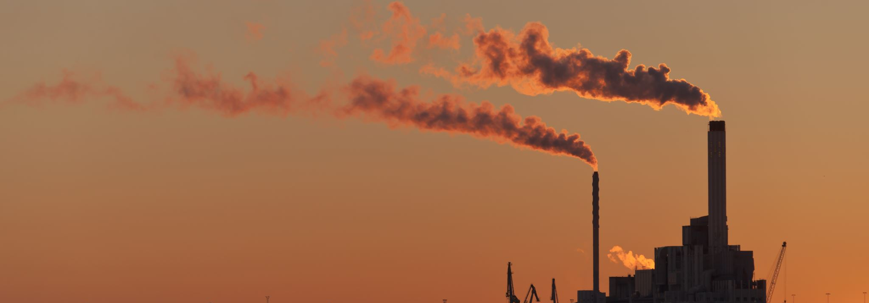
Implementation Phase
Replicate Testing Environment
Include More PurpleAir Monitors
One’s in the Field
Automate the Program
Runs Everyday Automatically
Store’s the .CSV/.JPG File’s
Debug as Needed

Slide 7

Continuation of the Program
Create
Create a Website to Report Data to
Implement
Implement MapMaker.py to create the Displayable Movie
Test
Test Thoroughly
Establish
Establish a Back End to the Website (Razor Code)
Login Interface
Database Remembers Username/Password
Register Page Appears When Logged In

Slide 8
Continuation of the Program (Continued.)
Registration Verification
Try and Catch for the PurpleAir Machine
If the Try and Catch Fails, the PurpleAir Machine is Offline
Verification Should Fail; Unsuitable Unit
If the Try and Catch Succeeds, the PurpleAir Machine is Online
Verification Should Succeed; Unit is Suitable for Connection
One Week Quarantine Period for Collected Data
Compare Data to Other’s Collected
Prevents the Skew from a Horrible Location
Ex. Near Grill, Dryer Vent, etc.
If it Clears; Allow Data, Failure Results in Human Override/Admin Okay

Slide 9
Continuation of the Program (Continued.)
Set a Reverify Date for Each Module in the Database
When that Date Comes Stop Data Collection
Wait for Human Override/Admin Okay
Create an Efficient Storage Technique for the Server’s
Huffman Technique
Lossless Data Compression Technique for Files
Only need to Store the Decode/Encode Booklet and Huffman Frequency Tree
FAQ’s Forum/Automated Help Chat
Allows for Quickly Helping Customers Even During Day’s Off

Slide 10
Three-Click Rule (For Website)
Steps need to be concise and efficient
User should only need to make three clicks or less
More clicks causes attention span to dissipate
Fast response time
If the website isn’t fast enough user’s lose patience
Expect feedback from a website in under five seconds
Why this rule?
It’s a common implication set by today’s technology standards
Gone are the day’s of Dial-Up connection speeds
Less steps for our user’s
Maintain their attention

Slide 11
History on Website Response Times
Account for roughly $2.6 billion a year in financial loss
User abandonment
In a study given by Akamai in September 2009
47% expect speeds of 2 seconds or less
40% abandon the page after three seconds of it loading
52% of consumers believer quick response times mean devotion to their happiness/loyalty
What this means?
The standard is set at loading in under three seconds

Slide 12
Try and Catch/Diagnostic Errors (Continued.)
Alert Admin(s)/Support Staff
Documents Problems Occurred
Allows for Customer Support
Grade Levels of Complexity
Aides in Gauging Troubleshooting Techniques
Each Code Will Fall into a Category
Ex. Network, Hardware, etc.

Slide 13
“What’s in it for me?”
Continuous Support/Troubleshooting For PurpleAir Monitor’s
Example:
Pittsburgh, New Hampshire Client Contacts Us Saying a Bear Ripped Apart His Sensor at 6:00 p.m. on a Friday Night.
With the Current Implication that Support is 24/7, Who’s Going to the Call?
Remember; the standards are high for speed (SEE Slide 11)
Pro’s | Con’s
Allows for Costumer’s to Keep Machine’s Maintained | Who’s Prepared to Support Costumer’s Off Hours?

Slide 14
Alternative Solution’s
Request for Maintenance Form
Disclaimer; Will Maintenance/Contact within the Next Business Day
Auto Generating FAQ’s
Keywords Will Bring Up Topic Articles that Will Attempt to Fix the Solution
If Still Not Fixed; It Will Bring You To The Maintenance Form
On-Call Service
Notifies The Closest Representative of the Maintenance
Redirect to PurpleAir Troubleshooting
Sends Them To PurpleAir’s Maintenance Capabilities

Slide 15
Future Set of Goals
Lossless Data Compression (Huffman method)
Website with Database
Login Credentials
Verification Process
Reverify Modules
Efficient Storage
Universal Model for Surrounding States
Long Paper Trail of Documentation
Maintenance Plan

Slide 16
Questions to JC
For the MapMaker.py program I was wondering where the call to the Keene State web server lies?
Doesn’t need to call Keene State’s Web Server
Uploads .JPG/.CSV to .HTML file
Allows for reconstruction of website
I would also like to know if there is any data loss that occurs with the withdrawal and depositing of said files?
No data loss; it’s going right to the .HTML file URL

Slide 17
Questions to JC (Continued.)
Keeping on with the idea of data, is there hypothetically a way that another program could compress these .CSV files in the terms of Huffman coding which is used in such products like Fax Machines; so when the program expands larger to a vast amount of PurpleAir Machines the team can continue to store data efficiently without loss despite the larger amount of .CSV files being obtained?
At Midnight, you could start a brand new .CSV file and compress the whole .CSV file from yesterday to backup to a server
Efficient storage of data

Slide 18
Questions to JC (Continued.)
Now, concerning the Fetch.py program; is the purpose of this program to generate a current list of available and verified PurpleAir Monitors that will be referenced over by the MapMaker.py?
These Programs are both standalone
Fetch.py also has a default list of Keene State’s ID tags above
Only seven are currently deployed
Fetch.py is a demo to call the five PurpleAir servers/API (Two are defunct)
We can use these to test code on
This is brought into the defaults via a .ini file
Fetch.py is a “Jiggle the Lock Program”
Meaning, It paves the way to calling the API’s and Servers for PurpleAir’s stored data

Slide 19
Questions to JC (Continued.)
If so, are they being referenced via an .ini file that I see is present in both programs provided?
The .ini files pass parameters to both programs
I’d like to also ask when calling the PurpleAir Machines to gather the information they send, are you simply establishing a connection via the ftp package that Python provides and calling it by it’s unique ID name like the list I see on the top of the Fetch.py program?
No
Fetch.py uses the file to have the ID tags
MapMaker.py uses it to set the sleep time and specifications for things like the .JPG movie
*ALSO* The stopfile is used as an emergency brake in MapMaker.py in the case of anything going wrong in the execution of the Movie making progress
Establish a connection through PurpleAir’s API/Server for data

Slide 20

Question to JC (Final)
Lastly, I was wondering if you could provide a procedure as to how you would test both programs both separately and combined?
Both are standalone
DON’T RUN MAPMAKER.PY
Will jam the Keene State Website’s data and disrupt the flow
Tailor made for the Keene State Website
Fetch.py is the demo
Scrape code for it to use in another program
Tailor make one for the State

Slide 21
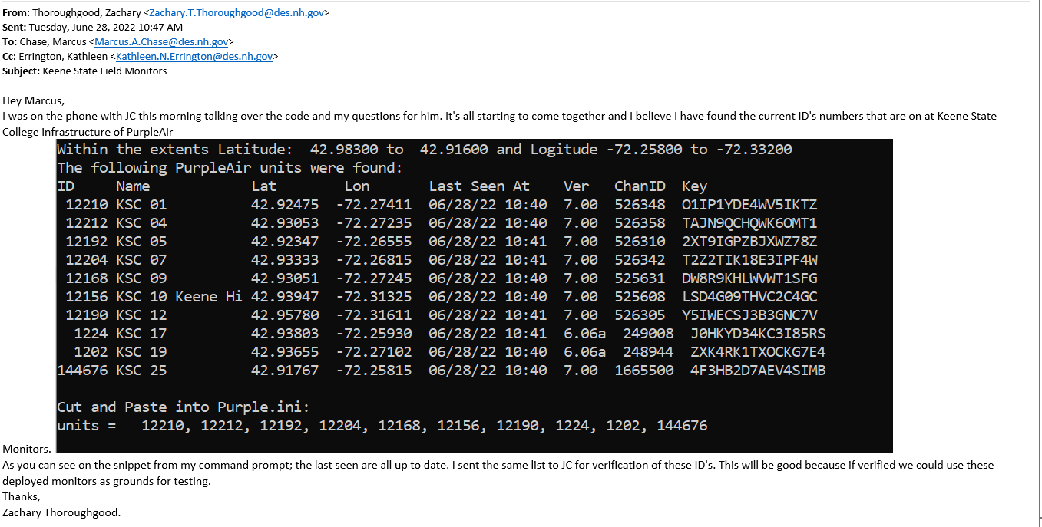
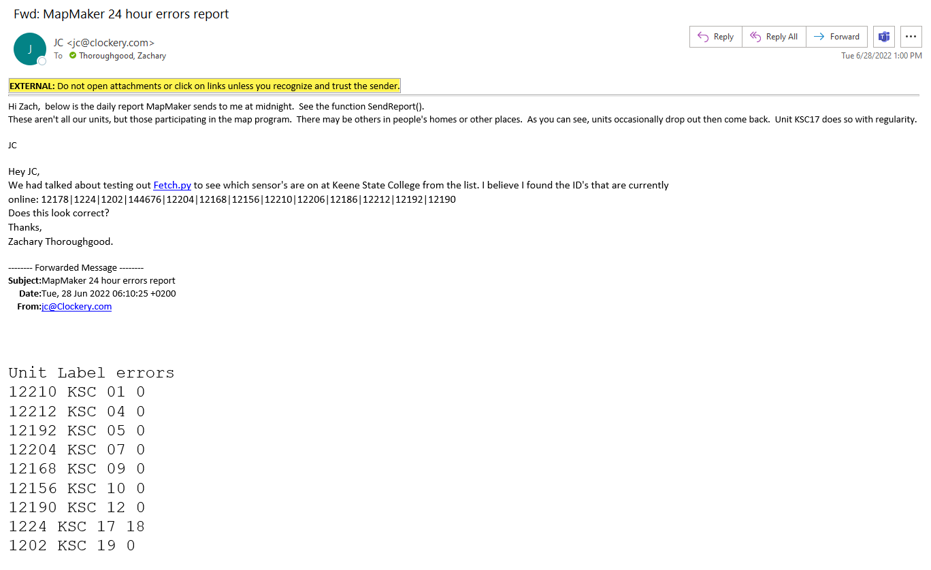
List Found By Zach Thoroughgood Using Fetch.py
JC’s Reported Data
*NOTED* Units Drop Out And Return Back
Keene State Modules Online

Slide 22
Testing on Keene State Modules
Able to call them via the Server/API on Fetch.py program
Shows last seen date/time
Scalped pieces of Fetch.py/MapMaker.py
Can create a .CSV
Program runs without errors
Need to write the PM data in .CSV
I need to figure out the writing process to .CSV
Also, need to figure out more of the data collection process from PurpleAir Server’s

Slide 23
Schedule
GantChartPurpleAir
Estimated Time Frame (Start to Finish)
40 Weeks (excluding holidays)
Approximately 1 year completetion
Estimated Time Frame (Deliverable)
11 Weeks (Around end time of Internship August 25)
Baring any setbacks/progressions

